Slide 1
ASCII

Slide 2
Digital Signals
Computers work with digital signals which consist of 1’s or 0’s.
Every piece of data and instruction must be converted to a code made up of 1’s and 0’s. We call this binary code - we will learn much more about this later on in the year.
A coding system is one which uses combinations of binary digits to represent data values uniquely
ASCII (American Standard Code for Information Interchange) and Unicode are the name of two very widely used coding systems.

Slide 3
ASCII
The ASCII code includes all the upper and lowercase characters on the keyboard, the numbers and other characters such as !, %, ? etc
Each character is represented by a decimal number which is then converted to binary code. A bit (binary digit) is a 0 or 1. The ASCII code for one character usually consists of 8 bits which is known as a byte.

Slide 4
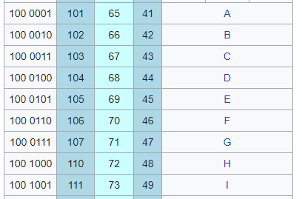
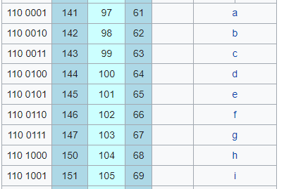
ASCII Table

Slide 5
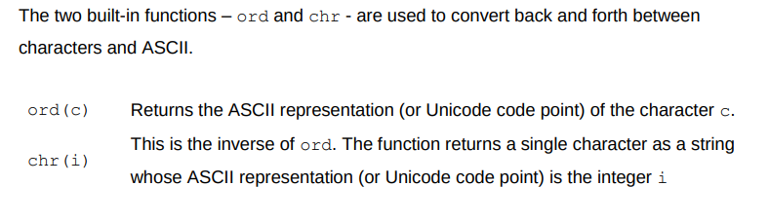
ASCII in Python

Slide 6
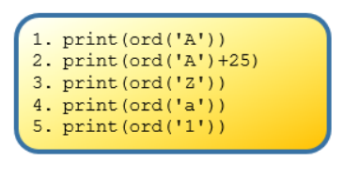
Ord Example
Line 1 outputs 65.
This is ASCII representation for the character ‘A’
Line 2 outputs 90, the ASCII representation for the character ‘Z’ (25 letters from A)

Slide 7
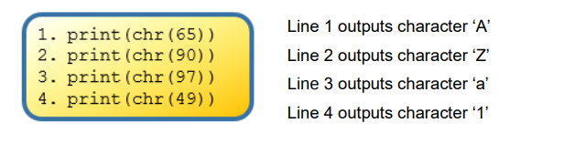
chr Example

Slide 8
Examples
https://replit.com/@suzannelinnane/ordchr#main.py

Slide 9
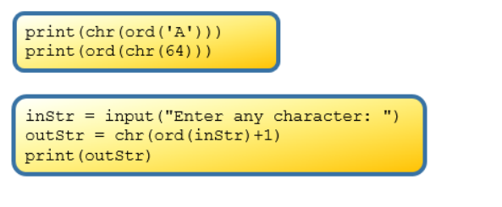
Try these and see if you can understand what’s happening

Slide 10
Encryption
Encryption is where information is encoded for security purposes.
A Caesar cipher is a way of encoding strings by shifting each letter by a fixed number of positions (called a key) in the alphabet.
Example.
If the key is 2 then the letter A would be encoded as C. Each letter is moved by 2.

